Slide 1


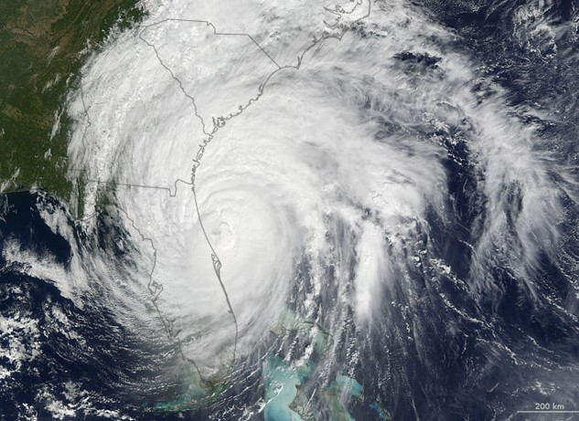
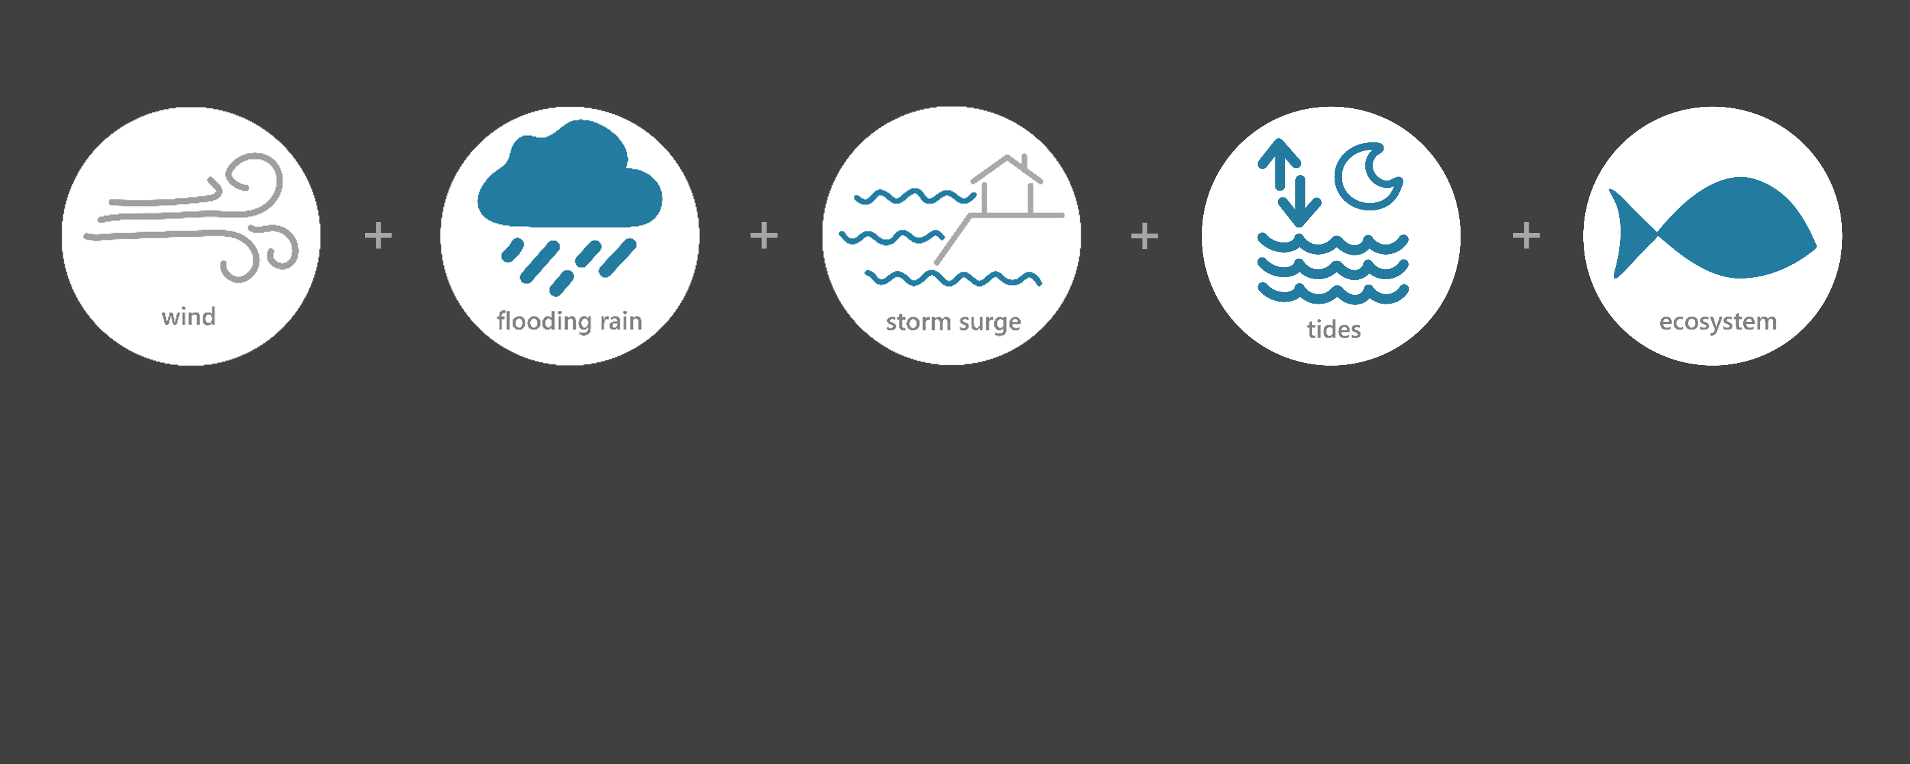

[ OCT 5 – OCT 10, 2016 ]
HURRICANE MATTHEW
3
Category
(major hurricane)
7.5
Inches of Rain
65
Miles per hour
of Max Wind Gusts
6-7
Feet of Storm Surge
(max)*
Image Credit: Earth Observatory, NASA
Monitoring the Impact of Hurricane Matthew at “GTM NERR”
On October 7th, the eye of Category 3 Hurricane Matthew came within 40 miles of St. Augustine at high tide
and resulted in several record-breaking storm surge levels in the southeastern coastal United States. Storm
surge flooding affected the St. Augustine area, including inundation levels of 6 to 7 feet above ground level in
the vicinity of Matanzas Inlet. The effects of Matthew were observed at the Guana Tolomato Matanzas (GTM) Research Reserve through the
System-Wide Monitoring Program (SWMP), which tracks short-term variability and long-term change in weather
and water quality in the areas surrounding St. Augustine and St. Johns County, Florida.
Data shown are based on the GTM weather monitoring site
*USGS storm tide sensor data at Fort Matanzas Beach
Created on April 13, 2022

Slide 2

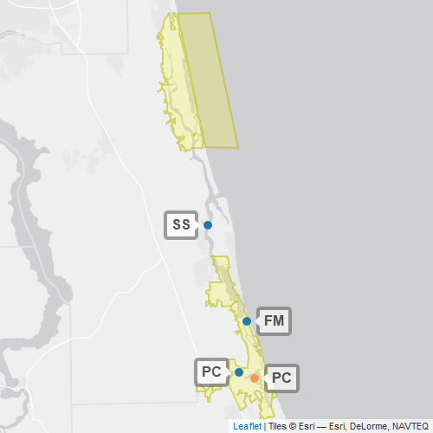
GTM
Guana Tolomato Matanzas (GTM) is one of 29 sites in the National Estuarine Research Reserve Systems (NERRS). Each site is a state-federal partnership that combines research, monitoring, and education to advance the understanding and management of estuarine environments.
NERRS
Centralized Data
Management Office
GTM
GTM Storm Monitoring
Weather Station
GTM NERR operates a weather station located at Pellicer Creek (PC) and maintains four continuous, long-term water quality stations at Pine Island (PI), San Sebastian (SS), Fort Matanzas (FM), and Pellicer Creek (PC) locations. GTM NERR is part of the SWMP. As Hurricane Matthew approached Florida, GTM NERR monitored the weather and water quality, collecting data every 15 minutes for the following parameters: air temperature, relative humidity, atmospheric pressure, rainfall, wind speed and direction, water temperature, depth, salinity, dissolved oxygen, turbidity, and pH.
Water Quality Sample Location

Slide 3
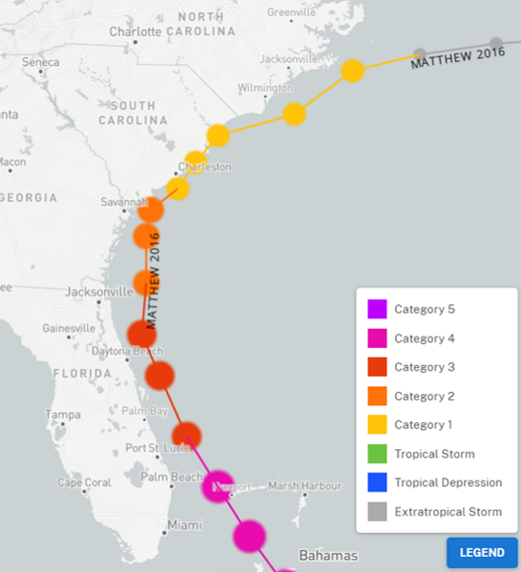
Matthew reached the coast of Haiti as a category 4 hurricane on Oct. 4. Matthew weakened to a category 3 hurricane on Oct. 7 about 35 n mi east of Vero Beach, Florida, and became a category 2 hurricane on Oct. 8 about 50 n mi east-northeast of Jacksonville Beach, Florida.
More than 1.2 million customers lost electrical power across the state. Water heights up to 4 ft above ground level occurred in the city of St. Augustine, especially near the bayfront and the San Sebastian River.
Source: https://oceanservice.noaa.gov/news/historical-hurricanes/
Matthew was a Category 3
on the Saffir–Simpson scale as
it approached the GTM reserve
and then weakened to a Category 2 as it moved north to Jacksonville.
NOAA NCEI estimates that wind and water damage totaled approximately $10 billion, making Matthew the 10th most destructive hurricane to affect the United States.
GTM
Aquatic life, like oysters, crabs, shrimp, fish, phytoplankton, etc. rely on specific levels of salinity and dissolved oxygen to thrive and survive. The weather impacts from Matthew caused significant drops in the levels of salinity and dissolved oxygen for varying periods of time, potentially stressing organisms.
Station | Date | Total Precipitation (in) | Average Intensity Precipitation (in/hr) | Max Wind Speed (mph) | Average Wind Speed (mph)
Pellicer Creek | 10/5/2016 | 0.96 | 0.040 | 23.0 | 15.5
Pellicer Creek | 10/6/2016 | 0.78 | 0.032 | 30.0 | 19.4
Pellicer Creek | 10/7/2016 | 5.60 | 0.233 | 64.6 | 38.7
Pellicer Creek | 10/8/2016 | 0.11 | 0.005 | 31.5 | 17.8
Pellicer Creek | 10/9/2016 | 0.00 | 0.000 | 21.9 | 12.3
The highest local rainfall and wind measurements were recorded when Matthew reached the Florida coast on Oct. 7.
Data reporting time periods for Hurricane Matthew: 10/5/2016 - 10/9/2016

Slide 4
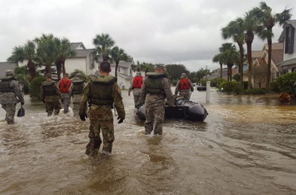
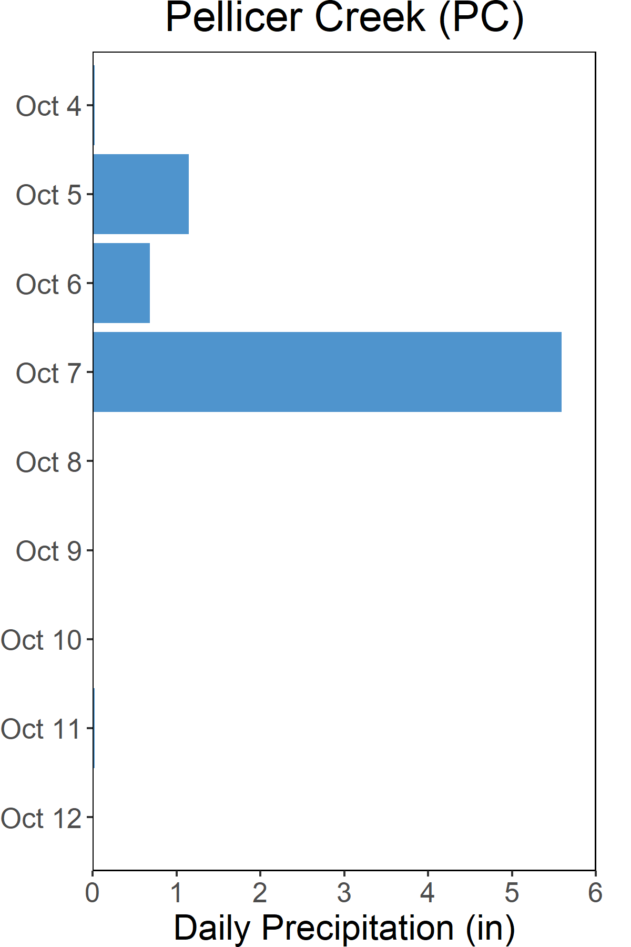
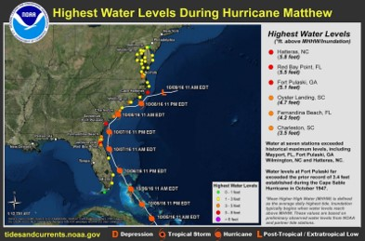

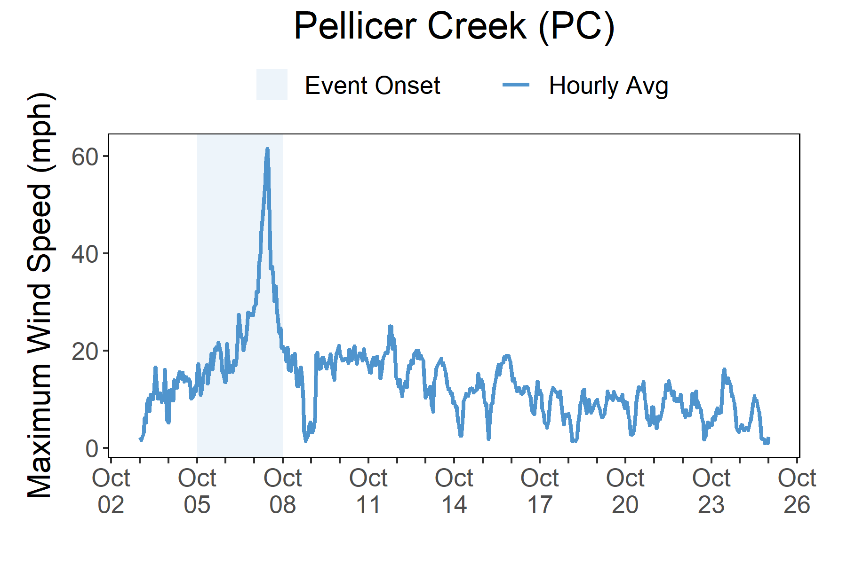

Rainfall
Matthew brought heavy rains,
high winds, storm surge, and
freshwater flooding to Florida.
Photo from the FL National Guard, taken in St. Augustine (St. Johns County) on October 9, 2016.
A total of 7.5 inches of rainfall fell in the reserve area over the course of a few days as a result of the heavy rain-producing Hurricane Matthew. A combination of heavy local rain, storm surge, and tides resulted in extensive flooding in Matanzas Inlet and Beach, St. Augustine, and surrounding St. Johns
County areas.
Torrential rains fell over east-central/northeastern Florida with 7.48 total inches of rainfall recorded at the Pellicer Creek weather station. The combined effect of storm surge and tide produced max inundation levels of 5-7 ft above ground level along the coasts of Flagler, St. Johns, and Duval Counties. USGS storm tide pressure sensors measured max inundations of 6-7 ft above ground level in the vicinity of Matanzas Inlet. The combination of storm surge and inland freshwater flooding caused by excessive rainfall resulted in damage to more than one million structures,
forcing businesses from Florida to North Carolina to temporarily close. The strongest winds were measured at Cape Canaveral with gusts of 104-107 mph. The max
wind speed recorded at Pellicer Creek was 65 mph. Matthew’s wind field caused structural damage to homes and businesses. Downed trees and utility lines caused massive power outages with more than 3.5 million customers from Florida to Virginia losing electrical power. Across the southeastern and eastern portions of the state, Matthew caused at least $1.5 billion in property damage to 100,000 buildings, left 900,000 people without electrical power, and caused environmental problems.
Rainfall measurements at the weather station from Oct. 4 through Oct. 12.
Wind Speed
Max wind speed was recorded on Oct. 7 at
the reserve at 65 mph.
Maximum Wind Speed readings at the weather station from Oct. 3 through Oct. 25.

Slide 5
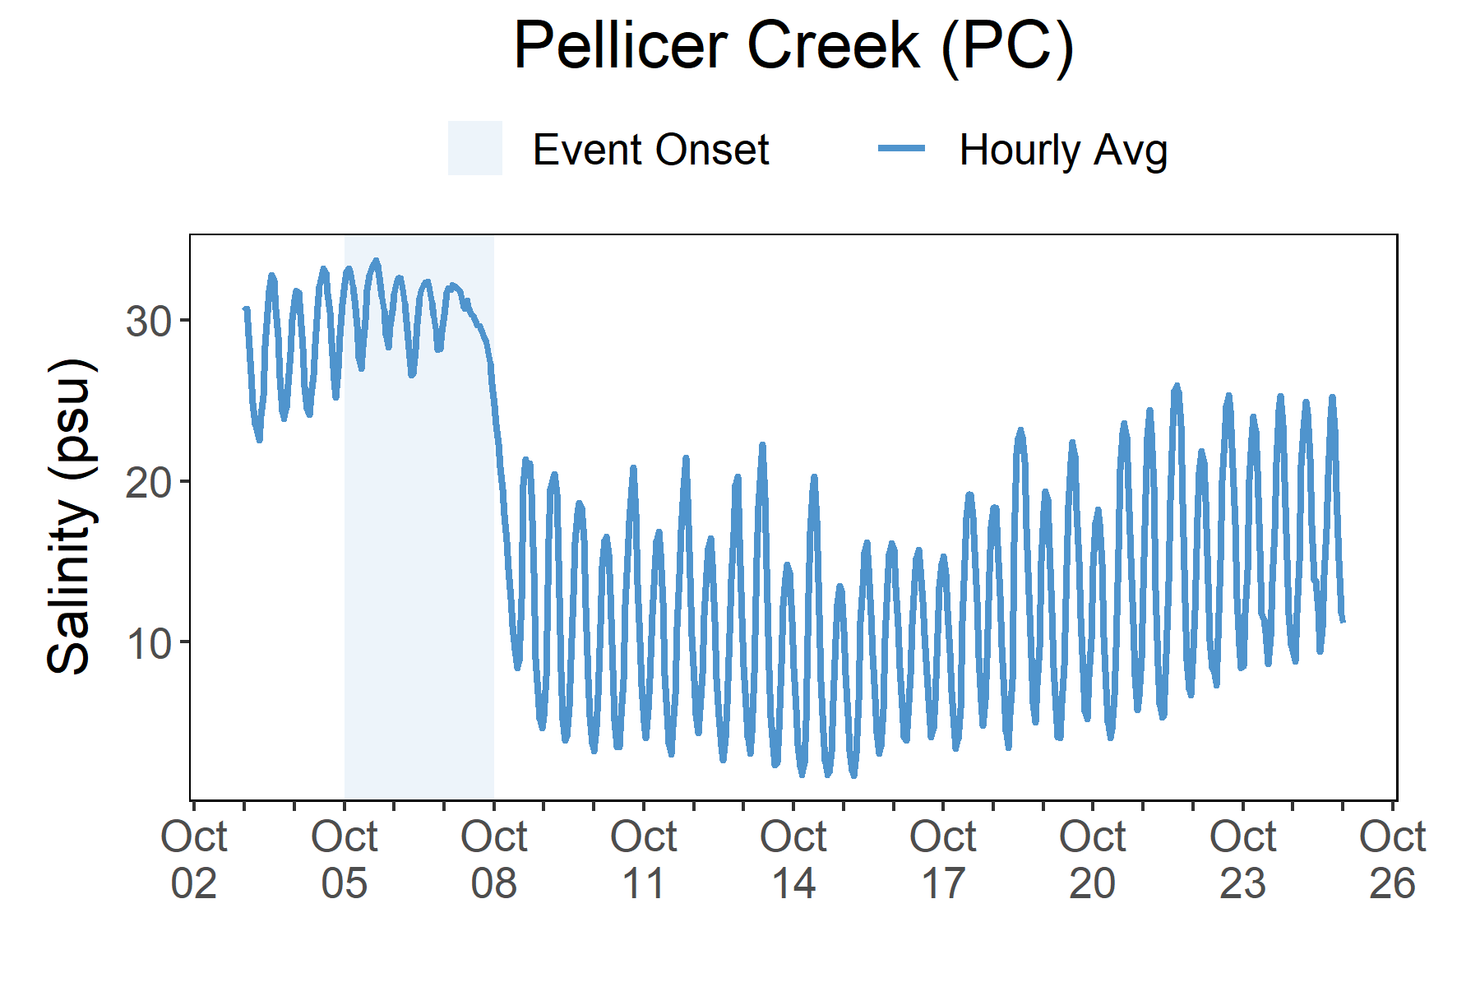
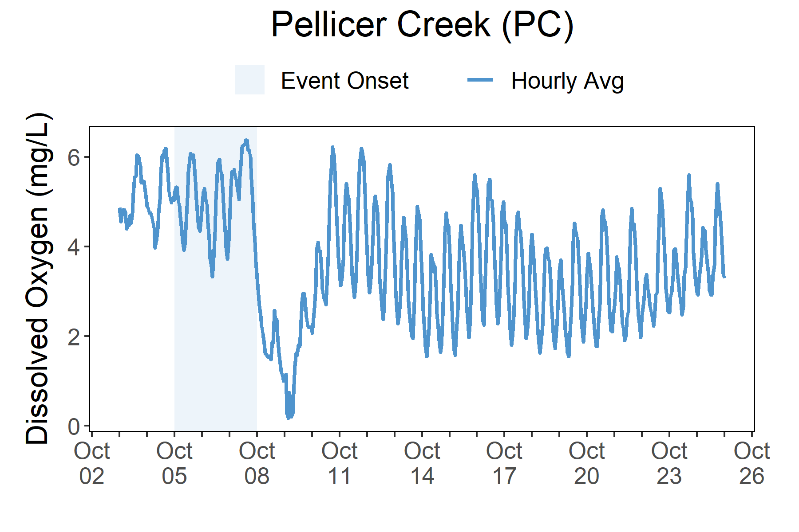
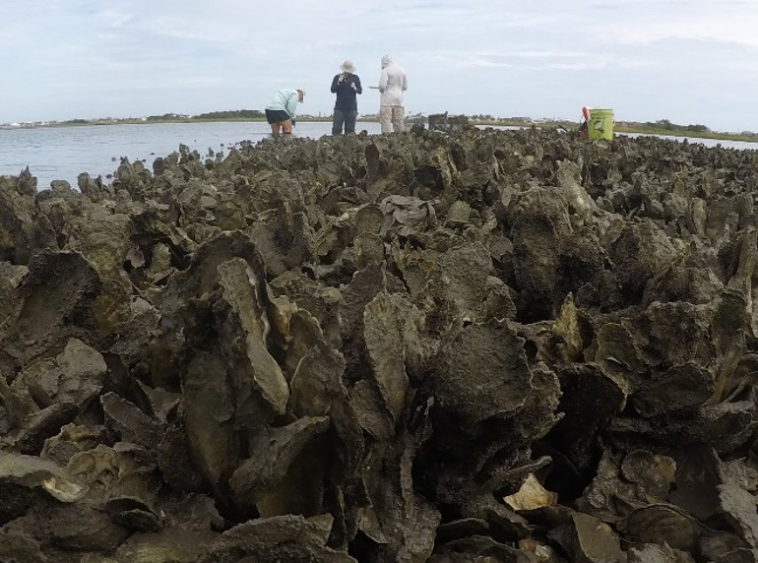
As Matthew traveled along the Florida coast on Oct. 8, both salinity levels and dissolved oxygen levels quickly dropped at Pellicer Creek.
Station | Date | Depth Maximum (ft) | Salinity Minimum (psu) | Salinity Maximum (psu) | Dissolved Oxygen Minimum (mg/L) | Dissolved Oxygen Maximum (mg/L)
Pellicer Creek | 10/5/2016 | 7.02 | 25.0 | 33.8 | 3.7 | 6.2
Pellicer Creek | 10/6/2016 | 7.41 | 26.0 | 32.6 | 3.1 | 6.0
Pellicer Creek | 10/7/2016 | 9.88 | 27.7 | 32.2 | 3.5 | 6.4
Pellicer Creek | 10/8/2016 | 8.99 | 8.1 | 29.1 | 1.3 | 5.7
Pellicer Creek | 10/9/2016 | 6.86 | 3.8 | 20.6 | 0.1 | 3.1
Data reporting time periods for Hurricane Matthew: 10/5/2016 - 10/9/2016
Salinity
Dissolved Oxygen
Post-Storm Levels
~<10 - <20 psu
Pre-Storm
Levels
>3.5 - 6 mg/L
Pre-Storm
Levels ~23 - >30 psu
Post-Storm Levels <1 mg/L
Salinity levels from Oct. 3 through Oct. 25.
Dissolved Oxygen levels from Oct. 3 through Oct. 25.
Salinity and dissolved oxygen levels recorded at Pellicer Creek show initial and post-storm impacts on water quality. Salinity levels quickly dropped as Matthew traveled along the Florida coast and remained at lower levels for more than a week after the hurrican had passed. Dissolved oxygen levels were impacted as well but the post-storm levels rebounded to pre-storm levels within a few short days. Dramatic changes in salinity and lower levels of oxygen (<4 mg/L) can cause stress to some aquatic organisms depending on the species and how long the levels deviate from what is normal. Water quality stresses can impact survival and future populations.
Oyster reef in the Matanzas River
south of St. Augustine, Florida.

Slide 6


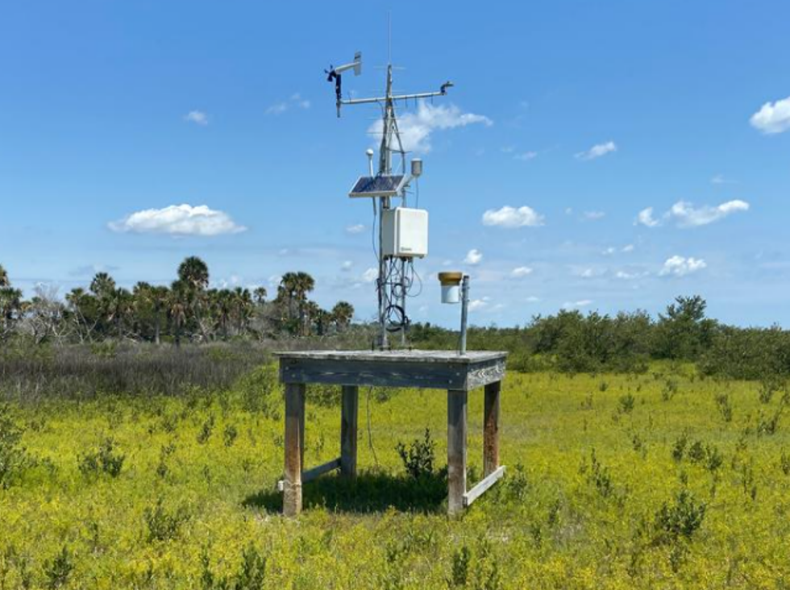
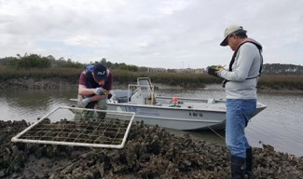
Kaitlyn Dietz, Coastal Training Coordinator e: gtmresearchreserve@gtmnerr.org p: 904.823.4500
Visit www.nerrsdata.org to view and download weather and water quality data from GTM NERR.
Interested in learning more? Visit www.gtmnerr.org. For video, news updates, and online storm data and
prediction visualization tools, check out our Storm Story Map at www.storm storymap.url.
@GTMResearchReserve

